Slide 1
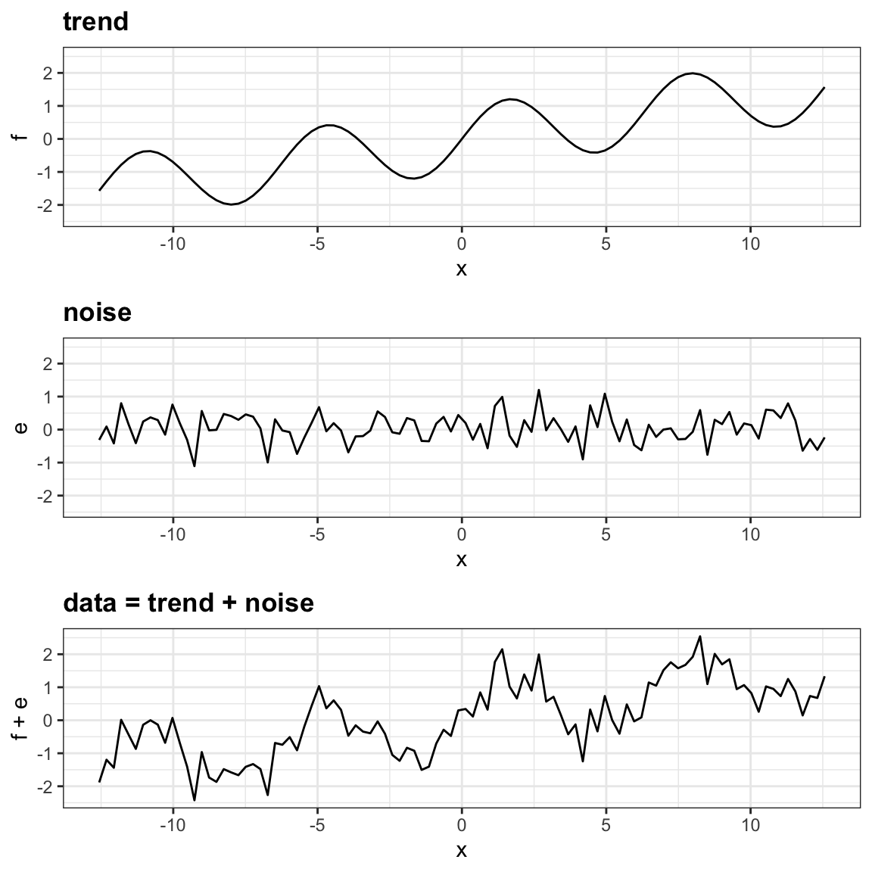
Source: Irizarry, R. A. (2019). Introduction to data science: Data analysis and prediction algorithms with R. Chapman and Hall/CRC.

Slide 2
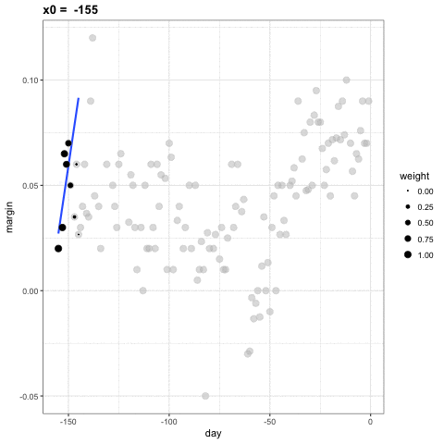
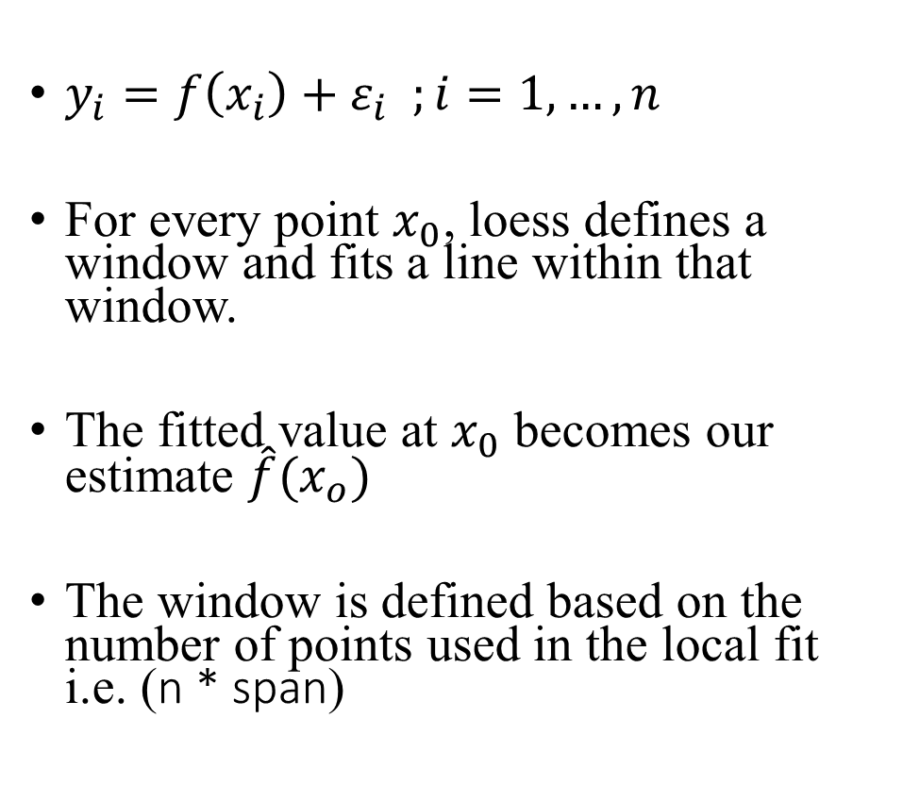
lowess
$y_{i}=f\left(x_{i}\right)+ε_{i} ;i=1,…,n$
For every point $x_{0}$, loess defines a window and fits a line within that window.
The fitted value at $x_{0}$ becomes our estimate $\hat{f}(x_{o})$
The window is defined based on the number of points used in the local fit i.e. (n * span)

Slide 3
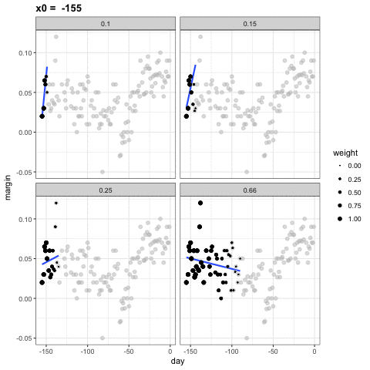
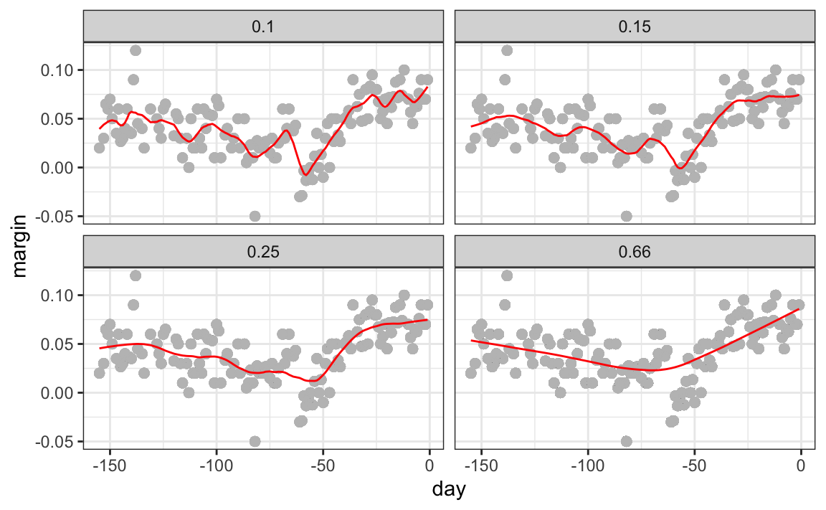
Different spans give us different estimates

Slide 4
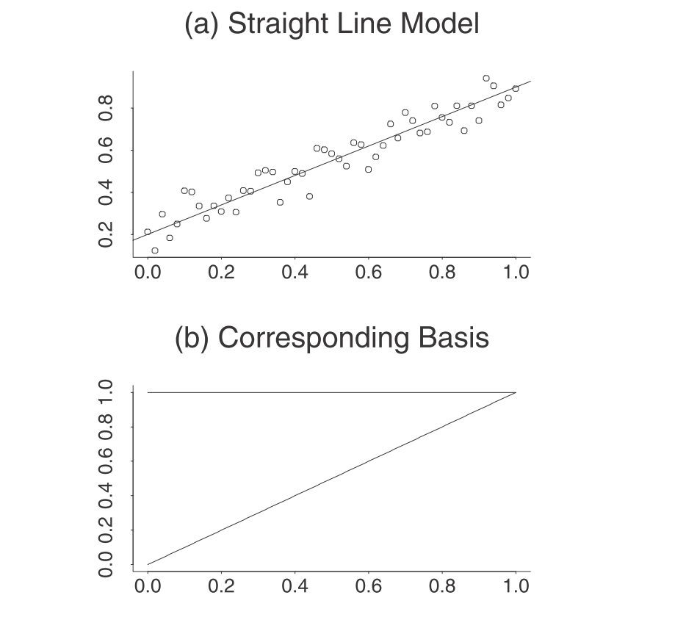
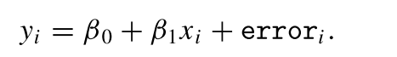
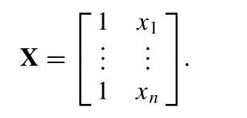
Splines
A spline is a way to represent a smooth function of a variable using basis functions.
(a)
(b)

Slide 5
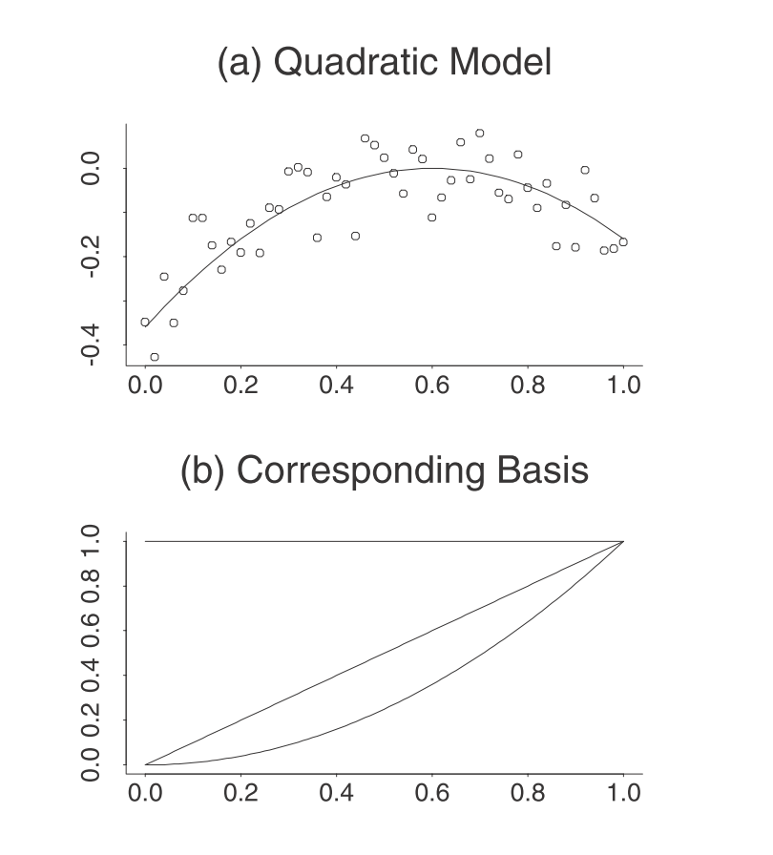
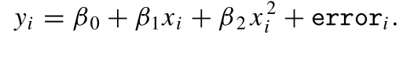
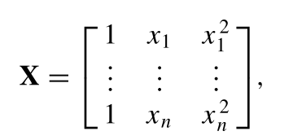
Splines
A spline is a way to represent a smooth function of a variable using basis functions.
(a)
(b)

Slide 6
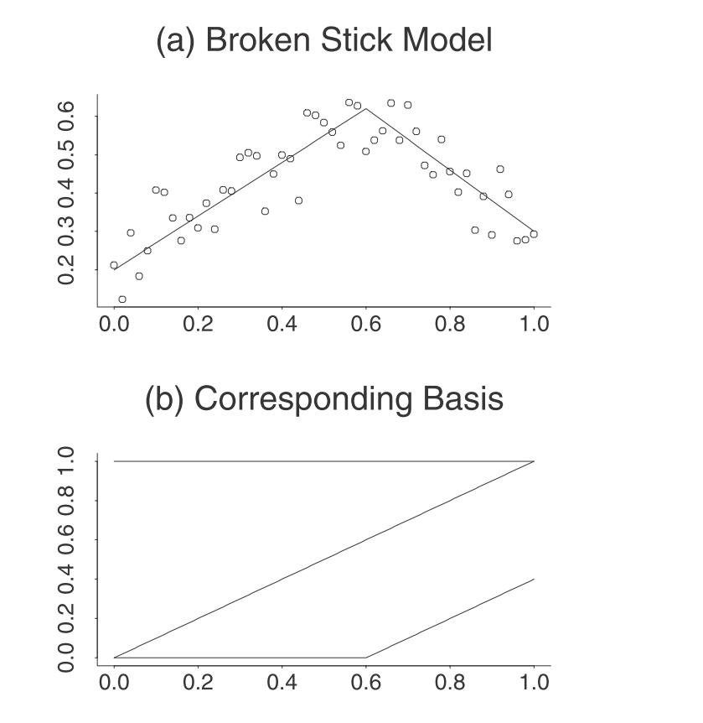
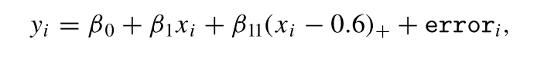
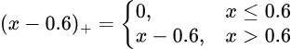
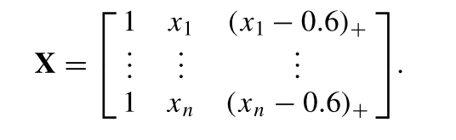
Splines
A spline is a way to represent a smooth function of a variable using basis functions.
(a)
(b)

Slide 7
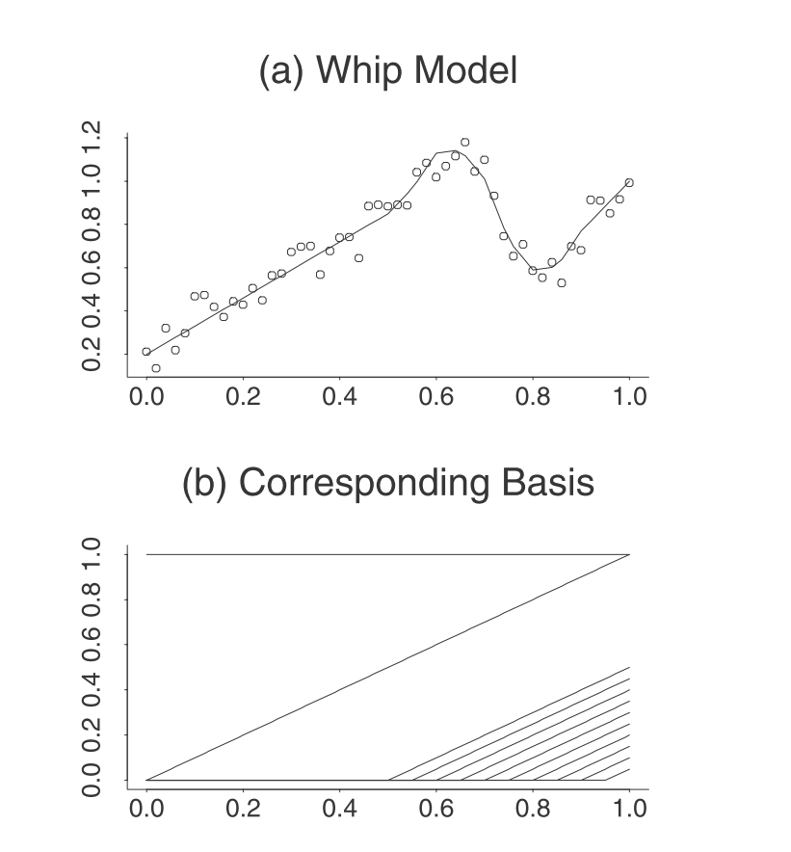
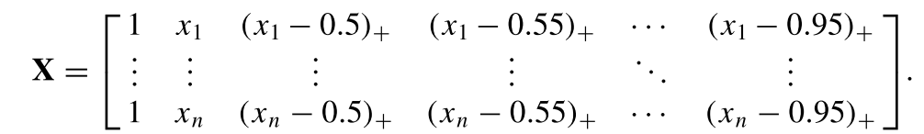
Splines
A spline is a way to represent a smooth function of a variable using basis functions.

Slide 8
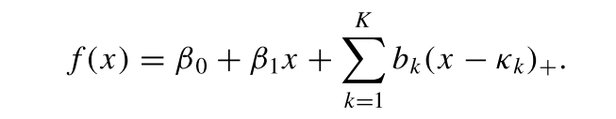
Splines
It is possible to handle any complex type of structure you like by simply adding more functions of the form (x − κ)+ to the basis .
The value of κ corresponding to the function (x − κ)+ is usually referred to as a knot.
This is because the function is made up of two lines that are “tied together” at x = κ.
Rather than referring to the spline basis function (x − κ)+, it is common to simply refer to its knot κ:

Slide 9
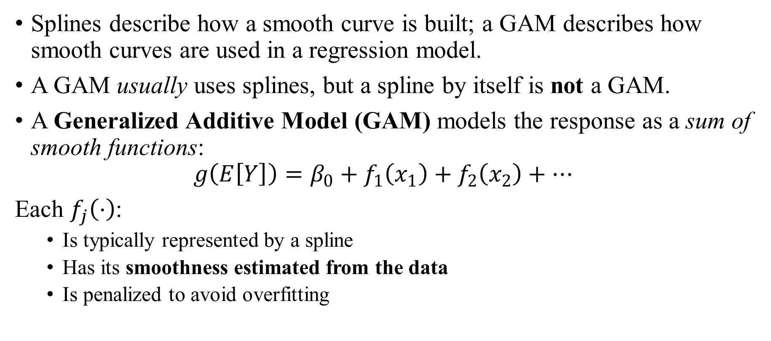
GAMs
Splines describe how a smooth curve is built; a GAM describes how smooth curves are used in a regression model.
A GAM usually uses splines, but a spline by itself is not a GAM.
A Generalized Additive Model (GAM) models the response as a sum of smooth functions:
$$g\left(E\left[Y\right]\right)=β_{0}+f_{1}\left(x_{1}\right)+f_{2}\left(x_{2}\right)+⋯$$
Each $f_{j}\left(⋅\right)$:
Is typically represented by a spline
Has its smoothness estimated from the data
Is penalized to avoid overfitting

